Slide 2
Table of Contents
1
Look Beyond My Disability, See The True Me – We are not that different (Video)
Community Chest Youth Day Appeal and the Impact of Giving
You Can Make A Difference
Look Beyond My Disability, See The True Me – ‘Fire In the Rain’ (Video)
2
3
4

Slide 3
Look Beyond My Disability,
See The True Me –
We are not that different (Video)
Everyone has the potential to achieve greatness in life.

Slide 4
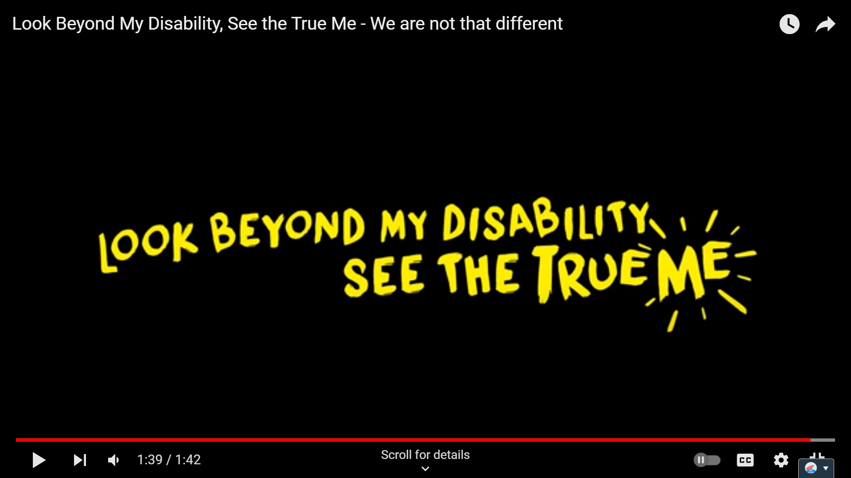
Look Beyond Disabilities
Each of us is unique. When we look beyond disabilities, we see the true potential in every individual. Watch this video to discover how everyone can pursue their passions and dreams to lead meaningful lives.
Notes:
Teaching Notes
Ctrl + click the image to watch the video on YouTube: Look Beyond My Disability, See the True Me - We are not that different - YouTube

Slide 5
Community Chest Youth Day Appeal
and the Impact of Giving
All of your support go towards empowering the lives of
our social service users.
Notes:
Teaching notes:
Question: What is a “social service user”?
Answer: Social services are a range of public services intended to provide support and assistance towards particular groups, especially towards the communities in need of support. Social service users are the people receiving these support of programmes.

Slide 6
Community Chest: The Philanthropy Engagement Arm of NCSS
Community Chest
Philanthropy and
Engagement arm of NCSS
National Council of Social Service (NCSS)
A membership organisation of more than 500 social service agencies
Provide leadership, enhance the capabilities of its members, advocate for social service needs, and strengthen partnerships within the social service sector
Channel resources to social service agencies, which support communities
in need in Singapore
Notes:
Teaching Notes
Question: What is a “social service agency”?
Answer: A social service agency is a non-profit organisation that provides services to benefit the community. It is more commonly known as a “charity” to the members of public.
Question: What is the meaning of “philanthropy”?
Answer: The desire to promote the welfare of others, expressed especially by the generous donation of money to good causes.

Slide 7
Youth Day Appeal (YDA)
Milestone Year
Since its inception in 1984, we gratefully celebrate the
40th Anniversary of the Youth Day Appeal, marking four decades of impactful journey in uplifting communities in need.
Campaign Objective
Aligned with the celebration of Youth Day, we encourage students to embrace the spirit of giving, fostering essential values of compassion, respect, and empathy towards communities in need from an early age.
Contributing Ways
Act: Donate using YDA resources or rally your school to fundraise in support of YDA!
Advocate: Raise awareness about the importance of giving to empower the communities in need.
Notes:
Teaching Notes
From another perspective, YDA aligns with the Ministry of Education’s Value-in-Action programme, aiming to develop students into socially responsible citizens who contribute meaningfully and actively to their school, community, and nation.
Additionally, the Children’s Day Appeal (CDA), coinciding with the Children’s Day celebration in October, advocates giving among preschools and primary schools to empower communities in need.

Slide 8
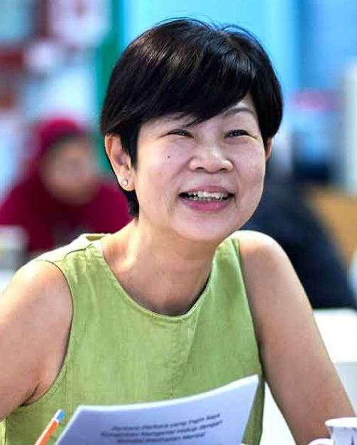
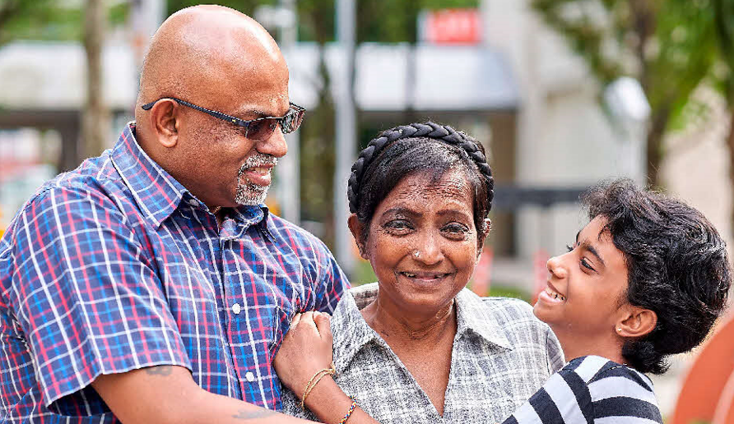
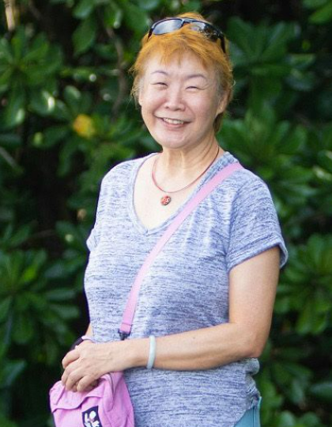
Your support goes towards empowering the lives of
Children with
special needs and Youth-at-risk
Persons with mental health conditions
Families in need
of assistance
Seniors in need
of support
Adults with disabilities
Notes:
Teaching Notes
Question: What is the meaning of youth-at-risk?
Answer: “Youth-at-risk” is a general term for a range of circumstances that place young people at greater vulnerability for problem behaviors, such as substance abuse, school failure, and juvenile delinquency, along with mental health disorders, such as depression and anxiety.

Slide 9
Meet Fizzy who is differently talented
Being diagnosed with an intellectual disability was never a barrier to Fizzy. In fact, she went on to thrive in academics and athletics at ASPN Tanglin School, a social service agency supported by Community Chest, which help students like Fizzy to embrace their limitations and soar beyond them. Fizzy's passion and talents include fusion dance, silat and soccer – all of which she excelled in; she has performed with a silat group and represented Singapore in the Olympics Asia Pacific S.E.A Unified Football Tournament. As a recipient of the Lee Kuan Yew (LKY) Exemplary Student Award in 2020, Fizzy shows us that the sky’s the limit when it comes to fulfilling one’s potential.

Slide 10
Understanding Intellectual Disability (ID)
What is Intellectual Disability (ID)?
ID is a development disorder where the individual faces more difficulty than others in grasping concepts and solving problems.
Individuals face significant limitations in intelligence and living skills to live and work in the community. Such skills include communication skills, self-care, self-direction and safety.

Slide 11
Understanding Intellectual Disability (ID)
APSN, which Fizzy was from, provides programmes and services for individuals with mid ID
IQ 50 – 70
Mid ID
IQ 35 – 49
Moderate ID
IQ 20 – 34
Severe ID
IQ < 20
Profound ID
80% of the
ID Population
12% of the
ID Population
7% of the
ID Population
1% of the
ID Population
Notes:
Resources
More information about ID can be found in 3-Part YouTube Shorts as follow:
1. https://www.youtube.com/shorts/cebpZoAJLVU
2. https://www.youtube.com/shorts/5aLNiCazXDU
3. https://www.youtube.com/shorts/YztMgRB5ZCw

Slide 12
Look Beyond Disabilities
Disability is a part of their lives, but it does not define who they are.
Watch this video to see heartfelt connections and uncover the remarkable strengths and stories of those with disabilities.
Notes:
Teaching Notes
Ctrl + click the image to watch the video on YouTube: Look Beyond My Disability, See the True Me - A Social Experiment - YouTube

Slide 13
You Can Make A Difference
Discover heartfelt ways to contribute and bring hope to those in need.

Slide 14
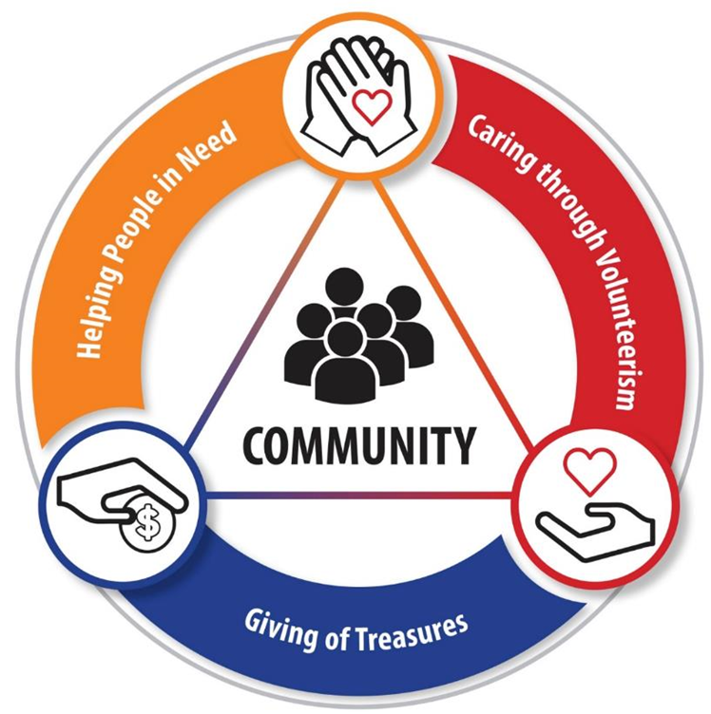
You Can Make A Difference
Time
E.g. Spend a fun afternoon with social service users like Fizzy, engaging in fun activities outside of their school programmes.
Treasures
Talents
E.g. Support YDA by donating part of your pocket money or organising fundraising activities at your school! 100% of your contributions will go directly to support SSAs like APSN Tanglin School through Community Chest, empowering individuals like Fizzy to fulfill their potential.
E.g. Sign up as a volunteer with SSAs like APSN Tanglin School and join their dedicated pool of volunteers. You will have various opportunities, including organising events for social service users like Fizzy.

Slide 15
Thank You For Making A Difference!
With each of your help, a total of $87,439.13 was fundraised through Youth Day Appeal 2023 to empower the communities in need.
Children with
special needs and Youth-at-risk
Persons with mental health conditions
Families in need
of assistance
Seniors in need
of support
Adults with disabilities

Slide 16
You Can Continue To Make A Difference
As we scan the PayNow QR code, let’s keep in mind:
To donate within your means.
No amount is too small to make a difference.
Encourage your parents to join you on your
giving journey too!
Notes:
Important reminders for teachers:
For schools that opted for donation envelopes:
Please pass all filled envelopes to the CCE/VIA Teacher-in-charge for their follow-up with Community Chest. Please inform them if there are any envelopes which have been submitted after the stipulated collection schedule for your school.
For teachers’ consideration to open up digital payment option (on the following slide) for students who are more comfortable with digital payment.
For schools that did not opt for donation envelopes:
Teachers may remove this slide.

Slide 17
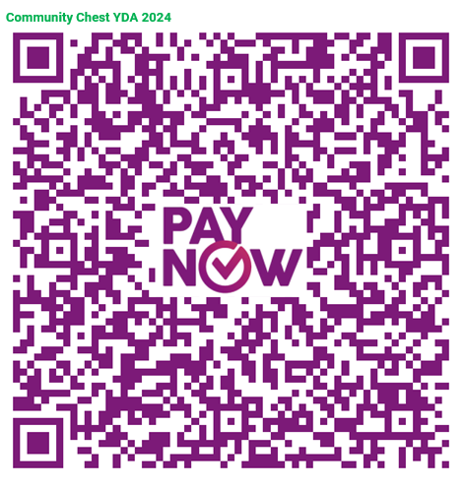
You Can Continue To Make A Difference
As we scan the PayNow QR code, let’s keep in mind:
To donate within your means.
No amount is too small to make a difference.
Encourage your parents to join you on your
giving journey too!
Notes:
Important reminders for teachers:
For schools that opted for customised PayNow QR code:
The PayNow QR code embedded is a generic QR code for digital payment towards Youth Day Appeal (YDA) 2024.
Please approach the CCE/VIA teacher-in-charge for the customised PayNow QR code if this modality is selected by your school.
For schools that did not opt for customised PayNow QR code:
Teachers may consider sharing the generic QR code for students who are more comfortable with digital payment.

Slide 18
You Can Make MORE Difference
In celebration with the 40th anniversary of the Youth Day Appeal, Toppers Education Centre will donate Sharity merchandise sets valued at $40 each to families in need for the first 250 class submissions! Rally your class now and make a difference!
Notes:
Teaching Notes
Fundraising has always been a cornerstone of Schools' Appeal, significantly impacting the lives of our social service users. Taking a small step toward a big change, we have incorporated a co-creation segment for participating schools starting with the Schools' Appeal 2022 edition.
Giving is for everyone – we can all contribute in various ways within our means. In addition to traditional fundraising, interactive class activities will enhance students’ understanding of our social service users. These activities will also create opportunities for greater student participation through hands-on experiences, unlocking monetary contributions from corporate donors for communities in need.

Slide 19
You Can Make MORE Difference
Padlet Discussion
Teachers are encouraged to use the Padlet "Discussion Board" to facilitate class discussions on the questions provided in the following slide.
Consider having breakout groups or allowing individual responses from students as part of the activity.
Submission
Teachers should email the Padlet discussion results (PDF) to Community Chest at NCSS_School@ncss.gov.sg. The submission deadline is the end of August, so keep those submissions coming!
Please remember to include the participating school's name and class in the email subject line.
Contribution
The recipient will receive an email acknowledgement once we have received your class. Every eligible submission earns a Sharity merchandise set donated for YDA 2024!
Send in your class discussion and get excited about your contribution making a difference today!

Slide 20
You Can Make MORE Difference
Padlet Discussion Questions
Each participating class should answer at least one of the questions below:
Why is it important for us, as youths, to participate in initiatives like the Youth Day Appeal, and how does getting involved help us better understand community needs and issues?
How can we effectively convey the importance of these giving efforts to our friends and schoolmates to inspire their participation? What are some ways we can share our experiences to promote empathy and action among our peers?
How do fundraising campaigns like the Youth Day Appeal foster a sense of responsibility and community spirit in us, and what methods can we use to communicate this impact effectively and encourage more schools to join in?

Slide 21
Look Beyond My Disability,
See The True Me –
‘Fire In the Rain’ (Video)
Engage in reflection by watching this video showcasing
abilities and harmony.

Slide 22
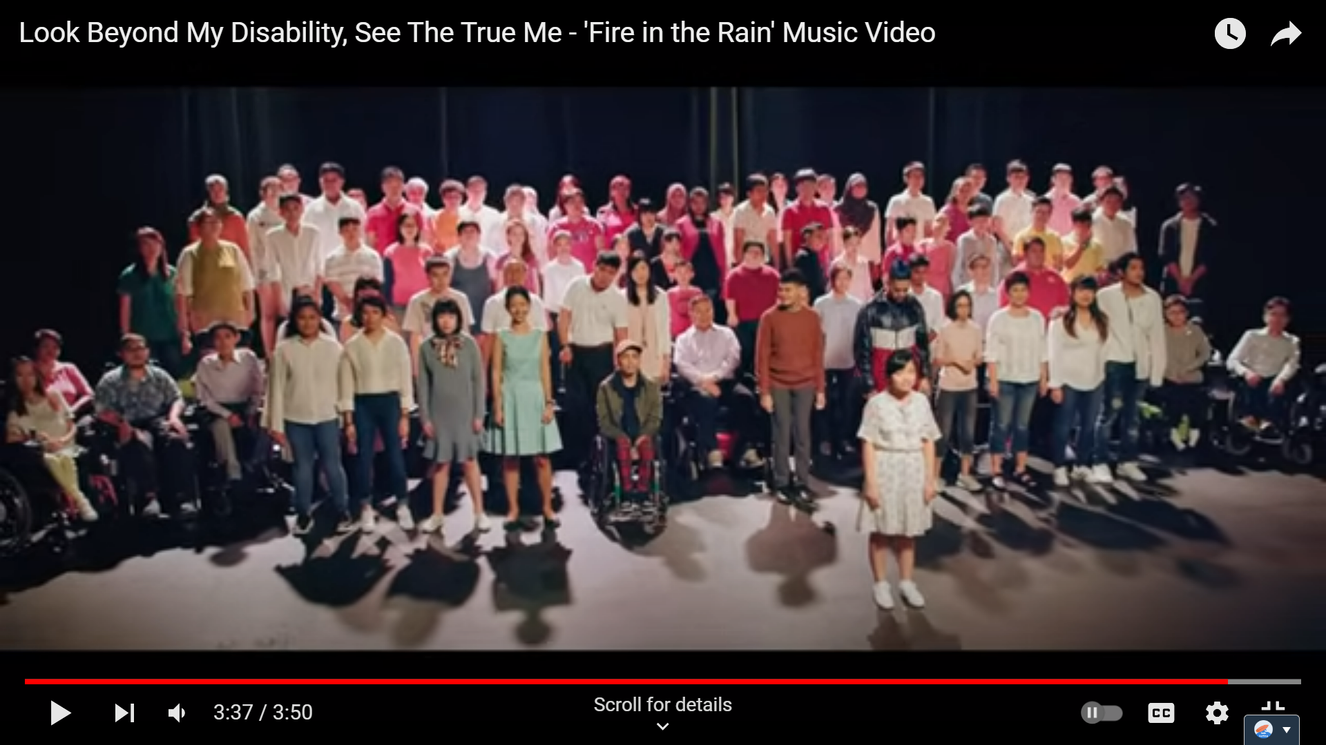
Look Beyond Disabilities
Each of us has unique gifts. By looking beyond disabilities, we can see how individuals with special needs contribute meaningfully to society. Watch this video – a celebration of abilities and harmony.
Notes:
Teaching Notes
Ctrl + click the image to watch the video on YouTube: Look Beyond My Disability, See The True Me - 'Fire in the Rain' Music Video - YouTube

Slide 23
Special Acknowledgement
A big thank you to Toppers Education Centre for their generous support of the Interactive Class Activity, commemorating the 40th Anniversary of the Youth Day Appeal and their contribution to empowering communities in need!

Slide 24
Thank you for being a part of
Youth Day Appeal 2024
and making a difference in uplifting communities in need!
Notes:
Teaching notes:
Question: What is a “social service user”?
Answer: Social services are a range of public services intended to provide support and assistance towards particular groups, especially towards the communities in need of support. Social service users are the people receiving these support of programmes.

Slide 25
Teaching Notes
No. | Question | Answer | Slide
1. | What is a “social service user”? | Social services are a range of public services intended to provide support and assistance towards particular groups, especially towards the communities in need of support. Social service users are the people receiving these support of programmes. | 5
2. | What is a “social service agency”? | A social service agency is a non-profit organisation that provides services to benefit the community. It is more commonly known as a “charity” to the members of public. | 6
3. | What is the meaning of “philanthropy”? | The desire to promote the welfare of others, expressed especially by the generous donation of money to good causes. | 6
4. | More about YDA | From another perspective, YDA aligns with the Ministry of Education’s Value-in-Action programme, aiming to develop students into socially responsible citizens who contribute meaningfully and actively to their school, community, and nation. Additionally, the Children’s Day Appeal (CDA), coinciding with the Children’s Day celebration in October, advocates giving among preschools and primary schools to empower communities in need. | 7

Slide 26
Teaching Notes
No. | Question | Answer | Slide
5. | What is the meaning of “youth-at-risk”? | “Youth-at-risk” is a general term for a range of circumstances that place young people at greater vulnerability for problem behaviors, such as substance abuse, school failure, and juvenile delinquency, along with mental health disorders, such as depression and anxiety. | 8
6. | More about the Interactive Class Activity | Fundraising has always been a cornerstone of Schools' Appeal, significantly impacting the lives of our social service users. Taking a small step toward a big change, we have incorporated a co-creation segment for participating schools starting with the Schools' Appeal 2022 edition. Giving is for everyone – we can all contribute in various ways within our means. In addition to traditional fundraising, interactive class activities will enhance students’ understanding of our social service users. These activities will also create opportunities for greater student participation through hands-on experiences, unlocking monetary contributions from corporate donors for communities in need. | 18

Slide 27
Resource Page
No. | Item and Embedded Links | Slide
1. | Look Beyond My Disability, See the True Me - We are not that different – YouTube | 4
2. | 3-Part YouTube Shorts about Intellectual Disability: 1. https://www.youtube.com/shorts/cebpZoAJLVU 2. https://www.youtube.com/shorts/5aLNiCazXDU 3. https://www.youtube.com/shorts/YztMgRB5ZCw | 11
3. | Look Beyond My Disability, See the True Me - A Social Experiment – YouTube | 12
4. | Look Beyond My Disability, See The True Me - 'Fire in the Rain' Music Video – YouTube | 22
5. | YDA Campaign Page for useful information including YDA campaign timeline and FAQ For additional details, please approach your CCE/VIA teacher-in-charge who is the main point of contact with Community Chest.

Slide 28
Important Reminders
No. | Item | Remarks | Slide
1. | Schools which opted for Envelope Donation | Please pass all filled envelopes to the CCE/VIA Teacher-in-charge for their follow-up with Community Chest. Please inform them if there are any envelopes which have been submitted after the stipulated collection schedule for your school. For teachers’ consideration to open up digital payment option on slide 17 for students who are more comfortable with digital payment. For schools that did not opt for donation envelopes: Teachers may remove slide 16. | 16
2. | School which opted for Customised PayNow QR Code | The PayNow QR code embedded is a generic PayNow QR code for digital payment towards Youth Day Appeal (YDA) 2024. Please seek the CCE/VIA teacher-in-charge for the customised PayNow QR code if this modality is selected by your school. For schools that did not opt for customised PayNow QR code: Teachers may consider sharing the generic QR code for students who are more comfortable with digital payment. | 17
3. | Schools which are participating in the Interactive Class Activity | We kindly request teachers to facilitate this activity and encourage all students to share their perspectives on the selected questions. Once the Padlet discussions are complete, please submit a PDF copy of the results to NCSS_School@ncss.gov.sg. Please ensure submissions are completed by the end of August to unlock a Sharity merchandise set for families in need of assistance. | 18 - 20

