Slide 1


Slide 2


Table of Contents
Look Beyond My Disability, See The True Me – We are not that different (Video)
Community Chest Children’s Day Appeal and How Giving Helps
3T’s: Ways To Give
Look Beyond My Disability, See The True Me – ‘Fire In the Rain’ (Video)

Slide 3

Look Beyond My Disability,
See The True Me –
We Are Not That Different (Video)
Everyone can do great things in life.
Notes:
Teaching Notes
Question: What is a “disability”?
Answer: “Disability” means someone might find some things harder to do. It is just one part of who they are, and they may need extra help.

Slide 4
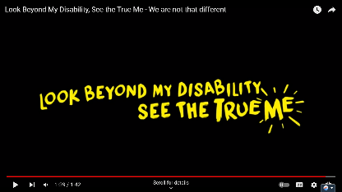
See The True Me
Everyone is special in their own way.
When we look past what makes us different, we see what people can do.
Watch this video to see how everyone can follow their dreams and be happy.
Notes:
Teaching Notes
Ctrl + click the image to watch the video on YouTube: Look Beyond My Disability, See the True Me - We are not that different - YouTube

Slide 5
Community Chest Children’s Day Appeal and the Impact of Giving
Your support helps people live better.

Slide 6


About Community Chest
Unite everyone and support more than 500 charities in getting better
A team in NCSS that gathers support to help people in need
Notes:
Teaching Notes
Question: What is a “charity”?
Answer: A charity helps people who need support by giving them money, food, or other required resources.

Slide 7
About Children’s Day Appeal (CDA)
2024 is a Special Year for CDA!
Since 1984, we have been helping people in need. And now, we are excited to celebrate 40 years of CDA!
CDA Goal
As we celebrate Children’s Day, let’s learn to be caring and sharing with those around us!
It starts with you and me!
How Can We Help
Give: Share some of your pocket money to support CDA!
Share: Tell your family and friends why it is important to care and help others!
Notes:
Teaching Notes
CDA aligns with the Ministry of Education’s Value-in-Action programme, aiming to develop students into socially responsible citizens who contribute meaningfully and actively to their school, community, and nation.
Timed with the Children’s Day celebration in October, the Children’s Day Appeal (CDA) encourages preschools and primary schools to promote giving and support communities in need.

Slide 8
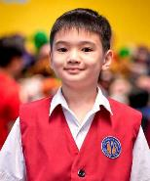
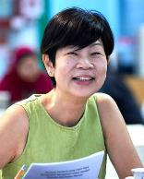
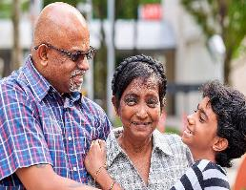
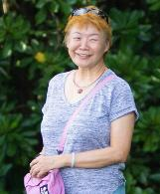
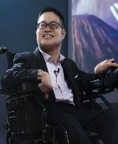
Your pocket money can help them live better
Children with
special needs and Youth-at-risk
Persons with mental health conditions
Families in need
of assistance
Seniors in need
of support
Adults with disabilities
Notes:
Teaching Notes
Question: What is the meaning of youth-at-risk?
Answer: “‘Youth-at-risk’ refers to young people who might face problems like drug use, failing school, or bad behaviour, and who might also struggle with feelings like being sad or worried.

Slide 9
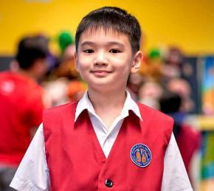
Meet Lucas who is differently gifted
Lucas was found to have a mild intellectual disability and autism when he was 2 years old.
At APSN Chaoyang School, he learns to manage his feelings, talk with others, and he loves dancing.
With support from his family and teachers, Lucas has grown to be a friendly and helpful boy.

Slide 10
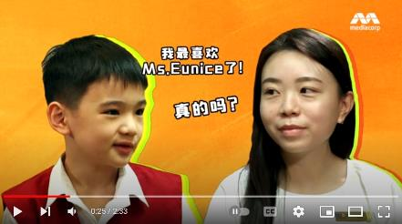
Meet Lucas who is differently gifted
Watch this video to learn more about Lucas and
how he spends a day at APSN Chaoyang School.
Notes:
Teaching Notes
Ctrl + click the image to watch the video on YouTube: Community Chest Charity TV Show 2023: Lucas (youtube.com)

Slide 11
3T’s: Ways to Give
Find out how we can help
people who need it.

Slide 12
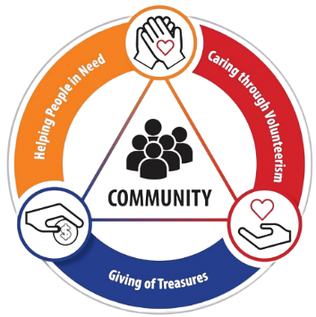
3T’s: Ways To Give
Time
You can have fun with children like Lucas during an afternoon of activities after school.
Treasures
Talents
You can support CDA by sharing some of your pocket money!
100% of your pocket money will help students like Lucas learn at APSN Chaoyang School.
You can sign up as a volunteer with your friends to help plan activities for children like Lucas.

Slide 13
Thank you for raising a total of $461,985.75
through Children’s Day Appeal 2023!
Children with
special needs and Youth-at-risk
Persons with mental health conditions
Families in need
of assistance
Seniors in need
of support
Adults with disabilities
Notes:
Teaching Notes
Question: What is the meaning of youth-at-risk?
Answer: “‘Youth-at-risk’ refers to young people who might face problems like drug use, failing school, or bad behaviour, and who might also struggle with feelings like being sad or worried.

Slide 14
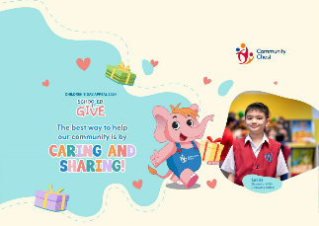
You Can Give To Make A Difference
As we share our pocket money, remember:
Give what you can.
Every amount counts.
Invite your parents to join you too!
Notes:
Important reminders for teachers:
For schools that opted for donation envelopes:
Please pass all filled envelopes to the CCE/VIA Teacher-in-charge for their follow-up with Community Chest. Please inform them if there are any envelopes which have been submitted after the stipulated collection schedule for your school.
For teachers’ consideration to open up digital payment option (on the following slide) for students who are more comfortable with digital payment.
For schools that did not opt for donation envelopes:
Teachers may remove this slide.

Slide 15
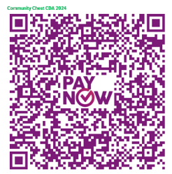
You Can Give To Make A Difference
As we scan the QR code, remember:
Give what you can.
Every amount counts.
Invite your parents to join you too!
Notes:
Important reminders for teachers:
For schools that opted for customised PayNow QR code:
The PayNow QR code embedded is a generic QR code for digital payment towards Children’s Day Appeal (CDA) 2024.
Please approach the CCE/VIA teacher-in-charge for the customised PayNow QR code if this modality is selected by your school.
For schools that did not opt for customised PayNow QR code:
Teachers may consider sharing the generic QR code for students who are more comfortable with digital payment.

Slide 16

Work Together As A Class To Make A Difference
To celebrate the 40th Anniversary of the Children’s Day Appeal, Toppers Education Centre will donate Sharity merchandise sets worth $40 each to needy families for the first 250 class submissions! Get your class involved in one of the activities and help make a difference!
Notes:
Teaching Notes
Fundraising is key to Schools' Appeal and helps our social service users a lot. Starting with Schools' Appeal 2022, we have added a new co-creation part for schools.
Giving is for everyone—we can all contribute in different ways. Besides using donation envelopes and PayNow QR codes, interactive class activities will engage students in hands-on experiences, helping them to learn more about the people supported by CDA.

Slide 17

Activity 1: Kindness Tree (Preschools and Primary 1 – 4)
Aim:
To create a Class or Individual Kindness Tree where each handprint shows an act of kindness.
Bonus:
Share a Class Photo with your Class/Individual Kindness Tree to NCSS_School@ncss.gov.sg to unlock the Sharity merchandise for the needy families!
Examples:
I helped my mum to clean the table.
I shared my toy with my friends.
I helped my teacher to carry the books.
Notes:
Activity Instructions
A. For a Class Kindness Tree
Step 1: Decorate Hands
Option 1: Paper Cutouts
Provide each child with a paper hand cutout.
Let them choose colours and designs for decorating their hand.
Option 2: Paint Handprints
Set up a paint station with washable paint.
Help each child dip their hand in paint and press it onto a sheet of paper to make a handprint.
Once the handprint dries, cut out the handprint shape from the paper.
Step 2: Think of Kindness
Ask each child to think about a kind act they have done or would like to do.
Encourage them to share their idea with you or the group.
Step 3: Write or Draw
Option 1: For Paper Cutouts
Provide markers or crayons.
Help children write or draw their kind act on their paper hand cutout.
Option 2: For Painted Handprints
After the handprints are dry and cut out, provide markers or crayons.
Assist children in writing or drawing their kind act on their painted handprint.
Step 4: Build the Kindness Tree
Help the children glue or tape their decorated handprints onto the tree branches.
Step 5: Share a Photo of the Students with the Kindness Tree
Once all the handprints are added, gather the children and review the Kindness Tree together. If time allows, have a brief sharing session where a few students describe their leaves and the acts of kindness they represent. This encourages discussion and reflection.
Capture a photo of the students with the Class Kindness Tree.
Email the photo to NCSS_School@ncss.gov.sg to unlock the Sharity merchandise for the needy families! Please let us know if you’re comfortable with us sharing the photo on social media; we will notify you before any public sharing.
B. For Individual Kindness Tree
Step 1. Distribute Worksheets:
Hand out the printed tree worksheets to each student. Each worksheet should feature a simple tree with a trunk and branches, and several empty spaces where leaves can be added.
Step 2. Choose an Approach:
Option 1: Fill in the Leaves: Students can directly draw or write their acts of kindness on the empty leaf spaces on their tree template.
Option 2: Paste Pre-Cut Leaves: Provide pre-cut leaf shapes. Students can write or draw their kind acts on these leaves and then glue or tape them onto the tree branches. spaces where leaves can be added.
Step 3. Build the Kindness Tree
Allow students to work on their Kindness Tree for about 3-4 minutes, focusing on adding at least one or two leaves with kind acts.
Step 4. Share a Photo of the Students with the Kindness Tree
If time allows, have a brief sharing session where a few students describe their leaves and the acts of kindness they represent. This encourages discussion and reflection.
Gather the students to capture a photo of the students with their Individual Kindness Trees.
Email the photo to NCSS_School@ncss.gov.sg to unlock the Sharity merchandise for the needy families! Please let us know if you’re comfortable with us sharing the photo on social media; we will notify you before any public sharing.

Slide 18



Activity 1: Kindness Tree (Preschools and Primary 1 – 4)
Create a Kindness Tree
Teachers are encouraged to involve students in creating either a Class or Individual Kindness Tree!
Submission
Teachers should send a Class Photo of your Kindness Tree to NCSS_School@ncss.gov.sg. The submission deadline is the end of October, so keep those submissions coming!
Please remember to include your school's name and class in the email subject line.
Contribution
You will receive an email confirmation once we receive your submission. Each eligible submission will earn a Sharity merchandise set, which will be donated to CDA 2024!
Send in your class photo and get excited about your contribution making a difference today!

Slide 19
Activity 2: Kindness Wall (Primary 5 – 6)
Padlet Discussion Questions
Each class is invited to respond to at least one of the following thought-provoking questions:
1. Why Should We Get Involved?: Why is it so important for us, as young people, to take part in initiatives like the Children’s Day Appeal? How does participating in such events help us better understand and address community needs?
2. Inspire Others with Your Story!: How can we effectively share the importance of giving and community involvement with our friends and classmates? What are some creative ways to share our experiences and inspire others to take action?
3. Building Community Spirit: How do fundraising campaigns like the Children’s Day Appeal help us develop a sense of responsibility and community spirit? What are some effective ways to communicate this impact and encourage other schools to join the cause? Share your ideas and reflections on Padlet, and let’s make a difference together!

Slide 20


Submission To Unlock Sharity Merchandise Donations!
Create a Kindness Tree
Teachers are encouraged to engage students in creating one of the following:
1. A Class or Individual Kindness Tree using handicraft
2. A Class or Individual Kindness Wall using Padlet
Submission
Teachers should submit one of the following:
A Class Photo of Your Kindness Tree
Padlet Discussions (PDF Format)
Send your submission to NCSS_School@ncss.gov.sg by the end of October.
Do include your school's name and class in the email subject line.
Contribution
You will receive an email confirmation once we receive your submission. Each eligible submission will earn a Sharity merchandise set, which will be donated to CDA 2024!
Send in your class photo and get excited about your contribution making a difference today!

Slide 21
Look Beyond My Disability,
See The True Me –
‘Fire In the Rain’ (Video)
Everyone is special in their own way.

Slide 22
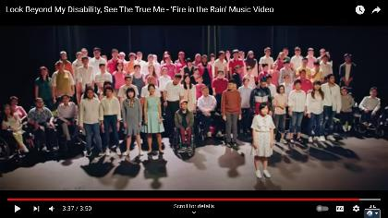
See The True Me
Everyone has special gifts. When we look past our differences, we can see how everyone has something amazing to bring to the group.
Watch this video to celebrate their gifts.
Notes:
Teaching Notes
Ctrl + click the image to watch the video on YouTube: Look Beyond My Disability, See The True Me - 'Fire in the Rain' Music Video - YouTube

Slide 23

A Big Thank You
Thank you, Toppers Education Centre,
for supporting the 40th Anniversary of
Community Chest Children’s Day Appeal!

Slide 24
Thank you for joining the Children’s Day Appeal and supporting those in need!
Caring and sharing starts with you and me!

Slide 25
Teaching Notes
No. | Question | Answer | Slide
1. | What is a “disability”? | “Disability” means someone might find some things harder to do. It is just one part of who they are, and they may need extra help. | 3
2. | What is a “charity”? | A charity helps people who need support by giving them money, food, or other required resources. | 6
3. | More about CDA | CDA aligns with the Ministry of Education’s Value-in-Action programme, aiming to develop students into socially responsible citizens who contribute meaningfully and actively to their school, community, and nation. Timed with the Children’s Day celebration in October, the Children’s Day Appeal (CDA) encourages preschools and primary schools to promote giving and support communities in need. | 7

Slide 26
Teaching Notes
No. | Question | Answer | Slide
4. | What is the meaning of “youth-at-risk”? | “Youth-at-risk” refers to young people who might face problems like drug use, failing school, or bad behaviour, and who might also struggle with feelings like being sad or worried. | 8
5. | More about the Interactive Class Activity | Fundraising is key to Schools' Appeal and helps our social service users a lot. Starting with Schools' Appeal 2022, we have added a new co-creation part for schools. Giving is for everyone—we can all contribute in different ways. Besides using donation envelopes and PayNow QR codes, interactive class activities will engage students in hands-on experiences, helping them to learn more about the people supported by CDA. | 16

Slide 27
Resource Page
No. | Item and Embedded Links | Slide
1. | Look Beyond My Disability, See the True Me - We are not that different – YouTube | 4
2. | Community Chest Charity TV Show 2023: Lucas (youtube.com) | 10
3. | Look Beyond My Disability, See The True Me - 'Fire in the Rain' Music Video – YouTube | 22
4. | CDA Campaign Page for useful information including CDA campaign timeline and FAQ For additional details, please approach your CCE/VIA teacher-in-charge who is the main point of contact with Community Chest.

Slide 28
Important Reminders
No. | Item | Remarks | Slide
1. | Schools which opted for Envelope Donation | Please submit all filled envelopes to the CCE/VIA Teacher-in-charge for their follow-up with Community Chest. Please inform them if there are any envelopes which have been submitted after the stipulated collection schedule for your school. For teachers’ consideration to open up digital payment option on slide 15 for students who are more comfortable with digital payment. For schools that did not opt for donation envelopes: Teachers may remove slide 14. | 14
2. | School which opted for Customised PayNow QR Code | The PayNow QR code embedded is a generic PayNow QR code for digital payment towards Youth Day Appeal (YDA) 2024. Please seek the CCE/VIA teacher-in-charge for the customised PayNow QR code if this modality is selected by your school. For schools that did not opt for customised PayNow QR code: Teachers may consider sharing the generic QR code for students who are more comfortable with digital payment. | 15
3. | Schools which are participating in the Interactive Class Activity | We kindly request teachers to facilitate the proposed activity and encourage all students to share their thoughts. After completing the activity, teachers should submit one of the following: A Class Photo of Your Kindness Tree Padlet Discussions (PDF Format) Please ensure submissions are emailed to NCSS_School@ncss.gov.sg by the end of October to unlock a Sharity merchandise set for families in need of assistance. | 17 - 20

