Slide 2
Table of Contents
1
Champion Every Potential (Video)
Community Chest Children’s Day Appeal and the Impact of Giving
How Can We Help?
Reflection and FAQ Session
2
3
4

Slide 3
Champion Every Potential (Video)
Everyone can achieve greatness in life.

Slide 4
Champion Every Potential
Everyone can be a champion and achieve greatness in life.
Watch the video.
Notes:
Note for Teachers:
Ctrl + click the image to watch the video on YouTube: Champion Every Potential (Full Film) – YouTube (https://www.youtube.com/watch?v=IKFRjRddcHs)
Sharing a relevant thought for teaching: “Greatness is not measured by what a man or woman accomplishes, but by the opposition he or she has overcome to reach his goals.” — Dorothy Height

Slide 5
Community Chest
Children’s Day Appeal and
the Impact of Giving
Your support will improve the lives of persons who need help.

Slide 6
About Community Chest
Community Chest brings people together to support persons who needs help
Everyone can help by donating or volunteering with the charities
Notes:
Teaching notes for Teachers:
Community Chest is the philanthropy and engagement arm of National Council of Social Service
What is “philanthropy”?
The desire to promote the welfare of others, expressed especially by the generous donation of money to good causes.

Slide 7
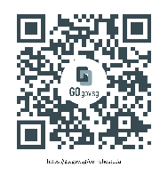
About Children’s Day Appeal
Sts Started in 1984
Beginning
On Children’s Day, students from kindergartens and primary schools are encouraged to help other children who need our support.
Through Children’s Day Appeal, students learn to care for and share with other children from a young age.
Objectives
CDA website
Sts 100% of your donations will support persons who need help.
Your help is important

Slide 8
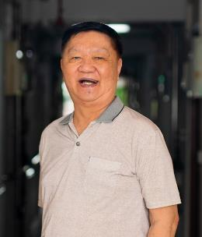
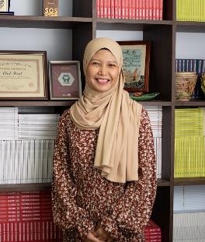
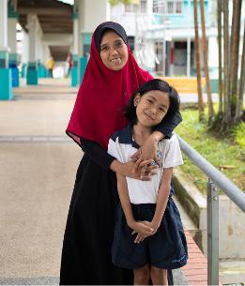
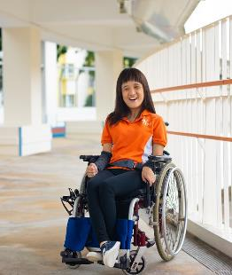
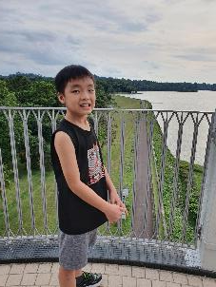
All of your donations will improve the lives of
Children with
special needs
and Youth at-risk
Seniors in need
of help
Persons who need mental health support
Families in need of help
Adults with disabilities

Slide 9
Meet Austen who is differently talented
Austen was born with Autism Spectrum Disorder.
His parents observed that Austen is talented at music. When he was 3 years old, he could play a tune on the piano after listening to his mum hum once.
However learning the piano was not easy for Austen. He disliked reading the musical notes.
Austen’s mother and teacher used many ways to teach him.

Slide 10
Meet Austen who is differently talented
Austen improved overtime as his mother and teacher at Rainbow Centre kept encouraging him to not give up learning the piano.
With his hard work, Austen has completed Grade 4. He is working towards completing Grade 5.
Learning the piano also helps Austen to focus for a longer period of time and builds his confidence.
The support from his mother and teacher in Rainbow Centre allows Austen to score better in his studies. His relationship with his mother has also improved.

Slide 11
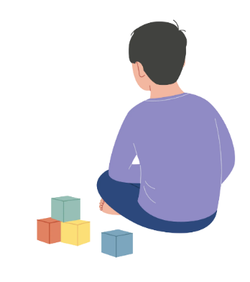
Understanding Autism Spectrum Disorder
What is Autism Spectrum Disorder?
It affects how a person think, feel, interact with others, and deal with their surrounding environment.
It is a lifelong condition that stays till old age.
There is no one cause of autism. Most cases of autism seem to be caused by both genetic and environmental factors affecting early brain development.
Notes:
Teaching notes for Teachers:
Refer to following sources for more details:
NCSS Quality of Life Studies at ncss.gov.sg/docs/default-source/ncss-press-release-doc/understanding-the-quality-of-life-of-adults-with-disabilities-pdf.pdf?sfvrsn=f5162c31_0
Autism Spectrum Disorder - ASD (Children) | National University Hospital (nuh.com.sg)
What is Autism & Autism Spectrum Disorder 2023 - SG Parents (autismrecovery.sg)

Slide 12
Understanding Autism Spectrum Disorder
Let’s be kind to children with Autism Spectrum Disorder who may behave differently from us.
Do not respond to Avoid eye contact Wants to be alone
his/her name
A..A..A..A..A..A..
Dislike loud noises Unable to understand Repeated speech
how others may feel or actions
Notes:
Teaching notes for Teachers:
Refer to following sources for more details:
NCSS Quality of Life Studies at ncss.gov.sg/docs/default-source/ncss-press-release-doc/understanding-the-quality-of-life-of-adults-with-disabilities-pdf.pdf?sfvrsn=f5162c31_0
Autism Spectrum Disorder - ASD (Children) | National University Hospital (nuh.com.sg)
What is Autism & Autism Spectrum Disorder 2023 - SG Parents (autismrecovery.sg)

Slide 13
Understanding Autism Spectrum Disorder
There are 400 new cases in Singapore every year. Each child can be screened at 18 months old, and have a more thorough test at 31 months old.
Autism Spectrum Disorder is a spectrum (has a range of conditions). Every child is different depending on the symptoms shown.
Some autistic people are very intelligent and need no support with daily life. Others may need more support/caregiver to take care of them.
Notes:
Teaching notes for Teachers:
Refer to following sources for more details:
NCSS Quality of Life Studies at ncss.gov.sg/docs/default-source/ncss-press-release-doc/understanding-the-quality-of-life-of-adults-with-disabilities-pdf.pdf?sfvrsn=f5162c31_0
Autism Spectrum Disorder - ASD (Children) | National University Hospital (nuh.com.sg)
What is Autism & Autism Spectrum Disorder 2023 - SG Parents (autismrecovery.sg)

Slide 14
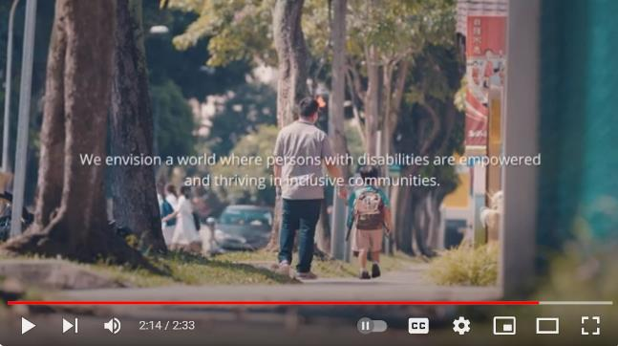
Understanding Autism Spectrum Disorder
Watch the video to see how Rainbow Centre supports
persons with autism spectrum disorder.
Notes:
Teaching notes for Teachers:
Ctrl + click the image to watch the video on YouTube: https://youtu.be/hu7fuCxID9k

Slide 15
How can we help?

Slide 16
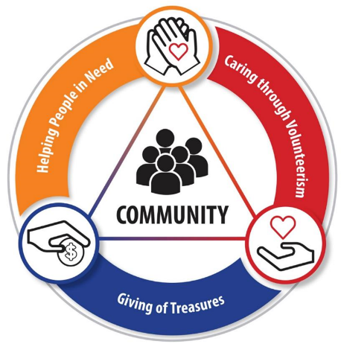
3 Ways of Giving
Time
E.g. Spend some time on every Sunday with elderly from the seniors home
Treasures
Talents
E.g. Donate your pocket money towards Community Chest Children’s Day Appeal
E.g. Tutor students from lower income families

Slide 17
Segment 1: Give your treasures as a class!
As each of us take an envelope of love, please remember:
To donate within your means.
No amount is too small to make a difference.
Notes:
Important reminders for teachers:
For schools that opted for donation envelopes:
This slide is meant to facilitate schools that opted for donation envelopes.
For schools that did not opt for donation envelopes, teachers may remove this slide altogether.
For teachers’ consideration to open up e-payment option (on the following slide) for students who are more comfortable with digital payment.
For schools that did not opt for drawstring bags: Teachers may remove this slide.

Slide 18
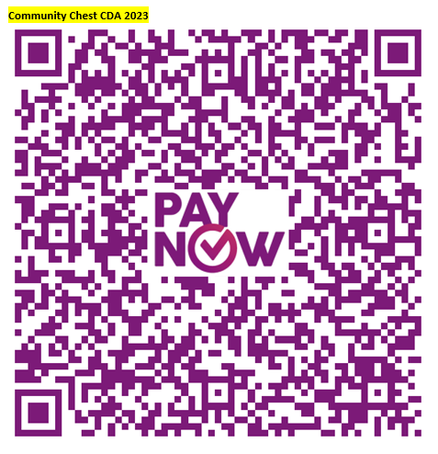
Segment 1: Give your treasures as a class!
As we scan the PayNow QR code and encourage others to do the same, please remember:
To donate within your means.
No amount is too small to make a difference.
Notes:
Important reminders for teachers:
For schools that opted for customised PayNow QR code:
The PayNow QR code embedded is a generic QR code for e-payment towards Children’s Day Appeal (CDA) 2023.
Please use the customised PayNow QR code if this modality is selected by your school. Please seek the CCE/VIA teacher-in-charge for the customised PayNow QR code.
For schools that did not opt for customised PayNow QR code:
- Teachers may consider opening up this option for students who are more comfortable with digital payment.

Slide 19
Segment 2: Donate your treasures as a class!
As Community Chest celebrates 40th anniversary this year,
Stamford American International School will donate 400
Sharity stationery sets for the first 400 class* poem submissions!
*Limited to 1 Sharity stationery set per participating class.
Notes:
Teaching notes for Teachers:
Fundraising has always been the legacy of Schools' Appeal that significantly impact the lives of our social service users. Making a small step towards a big change, we are also planning to incorporate a co-creation segment for participating schools starting from CDA 2022 edition.
Giving is for everyone – all of us can contribute in one way or another within our means. Other than the traditional way of fundraising, interactive class activities are planned to facilitate students’ learning towards our social service users and create opportunities for greater students' participation through hands-on activities, which unlocks monetary contributions from corporate donor for communities in need.
As teachers lead your classes for the class creation, stay tune for 2024 edition where a different activity will be introduced for Schools’ Appeal 40th Anniversary!

Slide 20
How to participate
Write a poem that demonstrates the theme:
Champion Every Potential,
Fulfil Their Dreams!
The poem should minimally have 8 lines. The poem title does not count as one.
Teachers to email the poem to NCSS_School@ncss.gov.sg between
5 October – 5 November 2023.
Remember to indicate the participating school's name, class in the email subject title.
There will be an email reply to acknowledge the poem received.
Each successful poem submission will earn a Sharity stationery set donated toward families in need!

Slide 21
Do’s and Don’ts
Be creative! You may create any content as long as it fits the theme.
Include your friends! Encourage every member of the class to share his / her ideas.
Please refrain from unsuitable, insensitive, hurtful, teasing or rude comments.
Please do not copy poems from any sources.

Slide 22
Reflection and FAQ
Share with your classmates about your learning points from the lesson on Children’s Day Appeal.

Slide 23
Special Acknowledgement
As Community Chest celebrates 40th anniversary this year, Stamford American International School will donate 400 Sharity stationery sets towards families in need of help.

Slide 24
THANK YOU FOR JOURNEYING WITH COMMUNITY CHEST
TO CHAMPION EVERY POTENTIAL!

