Slide 2
Table of Contents
1
Champion Every Potential (Video)
Community Chest Youth Day Appeal and the Impact of Giving
How Can We Help?
Reflection and FAQ Session
2
3
4

Slide 3
Champion Every Potential (Video)
Everyone has the potential to achieve greatness in life.

Slide 4
Champion Every Potential
Anyone can become a champion in their own right.
Let’s offer them the right support!
Notes:
Note for Teachers:
Ctrl + click the image to watch the video on YouTube: Champion Every Potential (Full Film) – YouTube (https://www.youtube.com/watch?v=IKFRjRddcHs)
Sharing a relevant thought for teaching: “Greatness is not measured by what a man or woman accomplishes, but by the opposition he or she has overcome to reach his goals.” — Dorothy Height

Slide 5
Community Chest
Youth Day Appeal and
the Impact of Giving
All of your support go towards empowering lives of our social service users.
Notes:
Teaching notes for Teachers:
What is a “social service user”?
- Social services are a range of public services intended to provide support and assistance towards particular groups, especially towards the communities in need of support. Social service users are the people receiving these support of programmes.

Slide 6
About Community Chest
Community Chest
The NCSS philanthropy and engagement arm
Develop collaborations to channel funds and resources to the social service agencies supporting the communities in need
National Council of Social Service (NCSS)
Supports more than 500 social service agencies in Singapore
Provides leadership and direction to the social service sector
Notes:
Teaching notes for Teachers:
What is a social service agency?
A social service agency is a non-profit organisation that provides services to benefit the community.
It is more commonly known as a “charity” to the members of public.
What is “philanthropy”?
- The desire to promote the welfare of others, expressed especially by the generous donation of money to good causes.

Slide 7
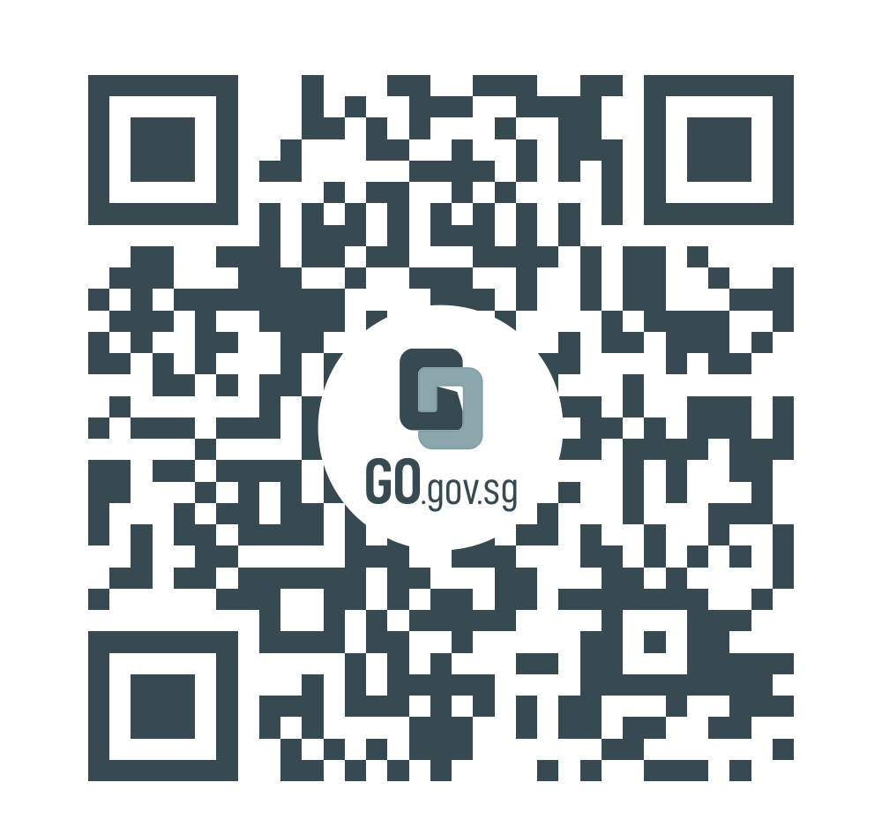
About Youth Day Appeal (YDA)
Sts Started in 1984, entering the 39th edition this year
Beginning
Coincides with Youth Day Celebration in July, and is an annual campaign to cultivate the culture of giving amongst secondary school and junior college students
It is aligned to Ministry of Education’s Values In-Action Programme to incalculate positive values such as compassion, respect, and kindness in students
Objectives
YDA website
Sts You can contribute your time, talent and treasures to help.
100% of your donations will go towards the 5 social causes
supported by Community Chest.
Ways of Giving

Slide 8
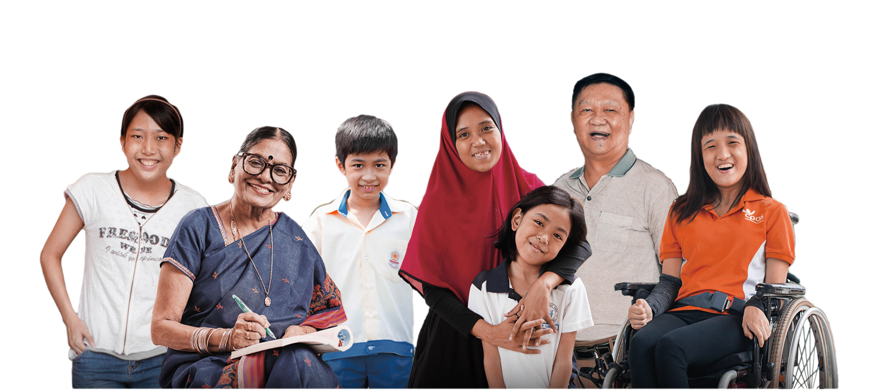
Your support goes towards empowering the lives of
Children with
special needs
and Youth-at-risk
Seniors in need
of support
Persons with mental
health conditions
Families in need of
assistance
Adults with disabilities

Slide 9
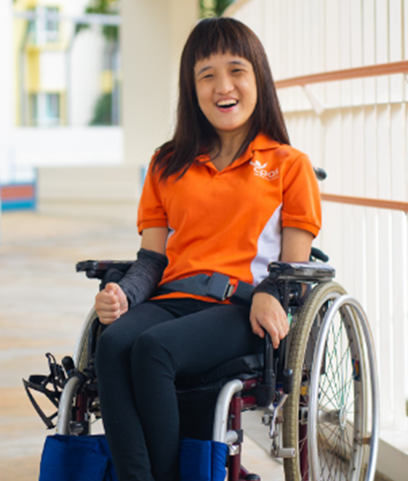
Meet Faye who is differently talented
Born with athetoid cerebral palsy, Faye has never let her physical limitations deter her from living a fulfilling life. Faye is a Boccia player and was part of Team Singapore Boccia that clinched a silver medal at the 2018 Asian Para Games. In 2018, Faye joined the Goodwill, Rehabilitation & Occupational Workshop (GROW) at Cerebral Palsy Alliance Singapore. Through GROW, Faye has been involved in a variety of assignments that enable her to earn a monthly allowance. Some of the assignments she has been involved in include box folding, towel folding and basic packing. The best part of work for Faye is the friends she interacts with.
Notes:
Teaching notes for Teachers:
Boccia: Means ‘ball’ in Italian, was initially designed for people with cerebral palsy. It is now played by athletes who have any kind of neurological impairment that affects their motor function.
*Read more on Boccia - Singapore National Paralympic Council (snpc.org.sg).
The Goodwill, Rehabilitation and Occupational Workshop (GROW) is a sheltered workshop providing vocational training and employment for adults with cerebral palsy or multiple disabilities. Trainees are involved in social enterprise initiatives and projects in our sheltered workshop, which develop their skills, build their self-esteem and provide an avenue for them to reach out socially to the public. It serves to equip trainees for work in open employment, the programme also includes mobility training and social engagement.
*Read more on Goodwill, Rehabilitation & Occupational Workshop (GROW) | CPAS.

Slide 10
Meet Faye who is differently talented
Faye has never let her physical limitations stop her. GROW ensures that her journey through life remains a fulfilling one.
Besides acquiring vocational skills and social skills, the workshop has also taught Faye, who is non-verbal, to communicate using an iPad. Since joining the workshop, Faye has grown to be more confident and independent. She hopes that one day, she will be able to travel to work on her own.

Slide 11
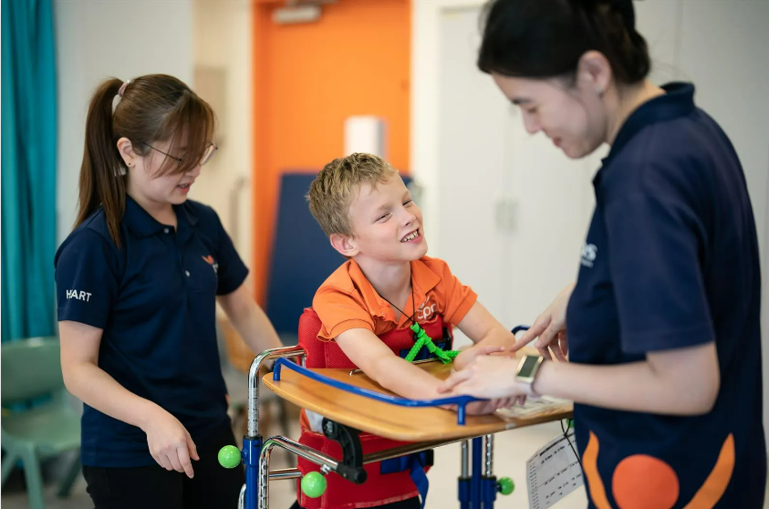
Understanding Cerebral Palsy
What is Cerebral Palsy?
Cerebral Palsy is a physical disability that affects movement and posture.
It is caused by illness or injury to the brain before or during birth, or early in life.
Image from Cerebral Palsy Alliance Singapore website
Notes:
Teaching notes for Teachers:
Refer to Cerebral Palsy Alliance Singapore | Help Children with Disabilities (cpas.org.sg) for more details.

Slide 12
Understanding Cerebral Palsy
5 Facts about Cerebral Palsy
It is a lifelong disability and it is not curable.
It affects individuals differently with varying degrees of disabilities.
It is caused by damage to the developing brain, which is not contagious.
Children diagnosed with cerebral palsy are generally expected to live to adulthood as it is not life-threatening.
Treatment is essential, and treatments can help greatly in the individual’s development, allowing them to work towards achieving their goals.
Notes:
Teaching notes for Teachers:
Refer to Cerebral Palsy Alliance Singapore | Help Children with Disabilities (cpas.org.sg) for more details.

Slide 13
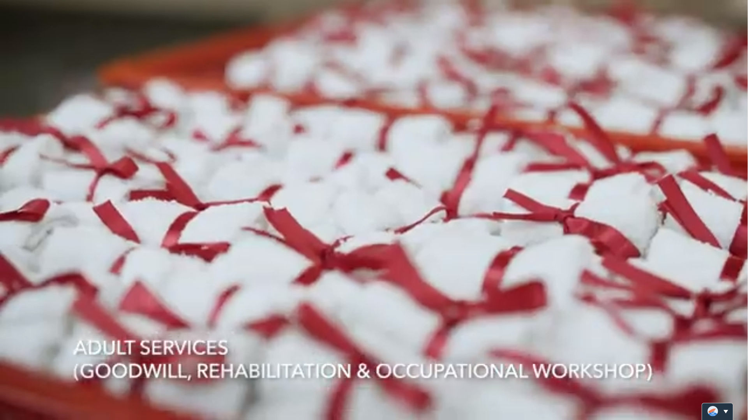
Understanding Cerebral Palsy
Watch how persons with cerebral palsy can reach their fullest potential and be empowered after receiving support from Cerebral Palsy Alliance Singapore.
Notes:
Teaching notes for Teachers:
Ctrl + click the image to watch the video on YouTube: Cerebral Palsy Alliance Singapore (https:/www.youtube.com/watch?v=feNBGFAfVcA)
Refer to Cerebral Palsy Alliance Singapore | Help Children with Disabilities (cpas.org.sg) for more details.

Slide 14
How can we help?

Slide 15
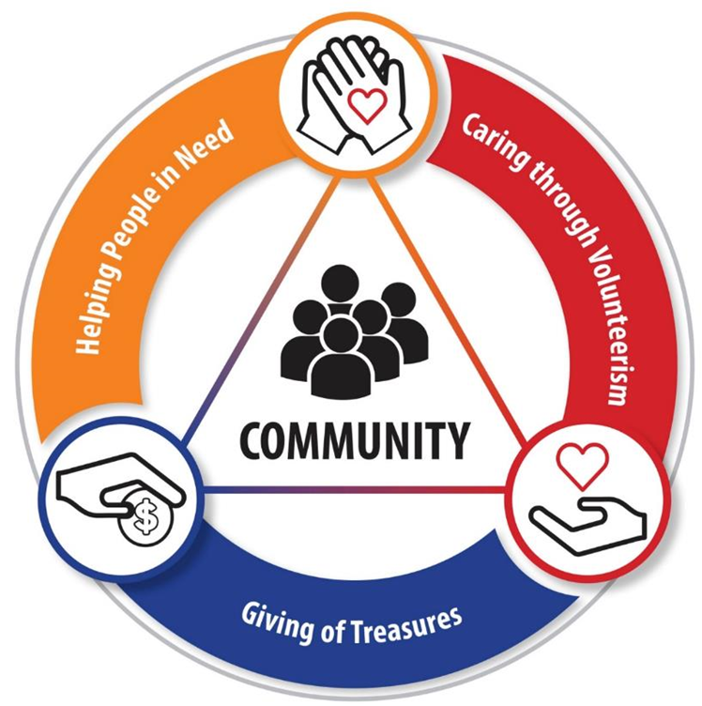
3 Ways of Giving
Time
E.g. Spend your weekend regularly with someone who needs support e.g. seniors from home for the aged
Treasures
Talents
E.g. Donate a small amount of your pocket money towards fundraising campaigns such as Community Chest Youth Day Appeal
E.g. Participate in mentoring programmes, such as guiding P1 students from lower-income families in English and Mathematics subjects

Slide 16
Impact of Giving Treasures
A total of $115,275.64 was fundraised through Youth Day Appeal 2022
to empower the communities in need.‬
Children with special needs and Youth-at-risk
Seniors in need
of support
Persons with mental
health conditions
Families in need of assistance
Adults with disabilities

Slide 17
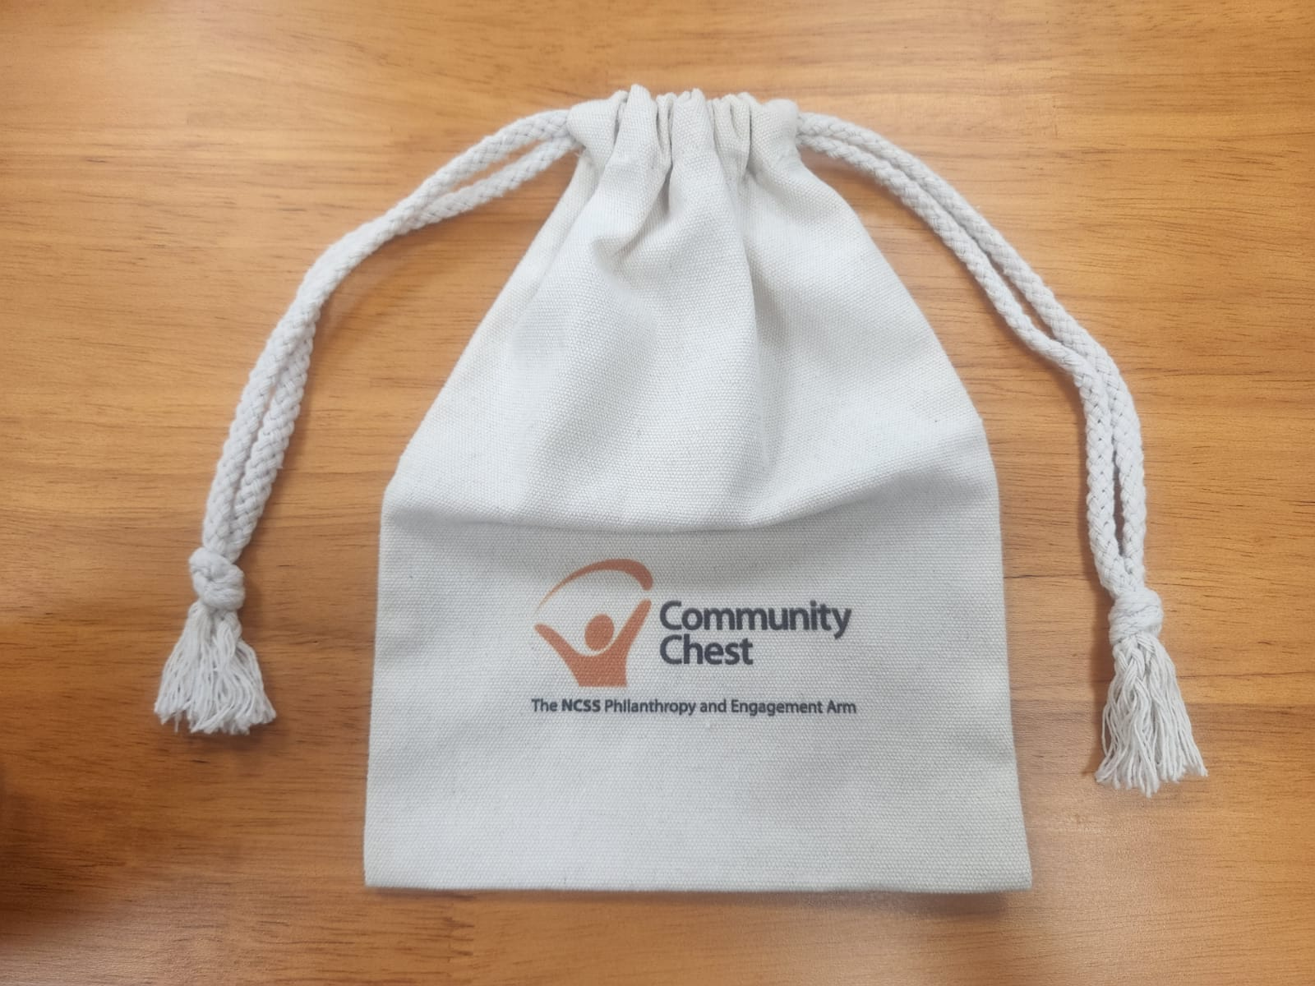
Segment 1: Give your treasures as a class!
As we pass the bag of love around the class,
please remember:
To donate within your means.
No amount is too small to make a difference.
Notes:
Important reminders for teachers:
For schools that opted for drawstring bags:
Before collecting the donations from the students, teachers are reminded to remove the cable tie from the bag.
After collecting the donations, pull the drawstrings to close the bag. Next, secure the bag with the cable ties below the drawstrings.
For photo illustrations, please refer to FAQ sheet on Youth Day Appeal (YDA) website: https://www.comchest.gov.sg/docs/default-source/campaigns/yda/yda-2023-faq.pdf
For teachers’ consideration to open up e-payment option (on the following slide) for students who are more comfortable with digital payment.
For schools that did not opt for drawstring bags: Teachers may remove this slide.

Slide 18
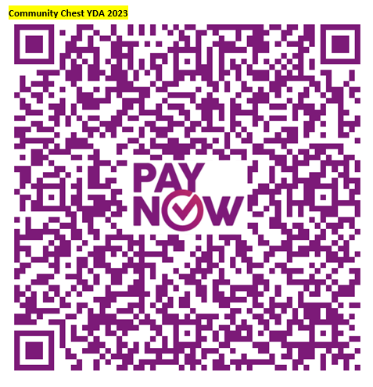
Segment 1: Give your treasures as a class!
As we scan the PayNow QR code and encourage others to do the same, please remember:
To donate within your means.
No amount is too small to make a difference.
Notes:
Important reminders for teachers:
For schools that opted for customised PayNow QR code:
The PayNow QR code embedded is a generic QR code for e-payment towards Youth Day Appeal (YDA) 2023.
Please use the customised PayNow QR code if this modality is selected by your school. Please seek the CCE/VIA teacher-in-charge for the customised PayNow QR code.
For schools that did not opt for customised PayNow QR code:
- Teachers may consider opening up this option for students who are more comfortable with digital payment.

Slide 19
Segment 2: Donate your treasures as a class!
In conjunction with Community Chest’s 40th anniversary,
Stamford American International School will donate 400
Sharity stationery sets for the first 400 class poem submissions!
Notes:
Teaching notes for Teachers:
Fundraising has always been the legacy of Schools' Appeal that significantly impact the lives of our social service users. Making a small step towards a big change, we are also planning to incorporate a co-creation segment for participating schools starting from YDA 2022 edition.
Giving is for everyone – all of us can contribute in one way or another within our means. Other than the traditional way of fundraising, interactive class activities are planned to facilitate students’ learning towards our social service users and create opportunities for greater students' participation through hands-on activities, which unlocks monetary contributions from corporate donor for communities in need.
As teachers lead your classes for the class creation, stay tune for 2024 edition where a different activity will be introduced!

Slide 20
How to be eligible
Write a poem that demonstrates the theme:
Champion Every Potential,
Fulfil Their Dreams!
The poem should minimally have 10 lines. The poem title does not count as one.
Teachers to email
the poem to NCSS_School@ncss.gov.sg between
3 July – 3 August 2023.
Remember to indicate the participating school's name, class in the email subject title.
There will be an email reply to acknowledge the poem received.
Each successful poem submission will earn a Sharity stationery set donated towards YDA 2023!
Notes:
Teaching notes for Teachers:
Fundraising has always been the legacy of Schools' Appeal that significantly impact the lives of our social service users. Making a small step towards a big change, we are also planning to incorporate a co-creation segment for participating schools starting from YDA 2022 edition.
As the messaging to the students goes: Giving is for everyone – all of us can contribute in one way or another within our means. Other than the traditional way of fundraising, interactive class activities are planned to facilitate students’ learning towards our social service users and create opportunities for greater students' participation through hands-on activities, which unlocks monetary contributions from corporate donor for communities in need.
As teachers lead your classes for the class creation, stay tune for 2024 edition where a different activity will be introduced!

Slide 21
Do’s and Don’ts
Be creative! You may create any content as long as it fits the theme.
Include your peers! Encourage every member of the class to contribute his / her ideas.
Please refrain from inappropriate, insensitive, hurtful, mocking or critical comments.
Please do not plagiarise poems from any sources.

Slide 22
Reflection and FAQ
Share with your classmates about your learning takeaways from the lesson on Youth Day Appeal.

Slide 23
Special Acknowledgement
In conjunction with Community Chest’s 40th anniversary, Stamford American International School will donate 400 Sharity stationery sets towards families in need of assistance.

Slide 24
THANK YOU FOR JOURNEYING WITH COMMUNITY CHEST
TO CHAMPION EVERY POTENTIAL!

